Slide 1
Persistently identifying administrative data: should we care?
Dr. Kakia Chatsiou
Dept. of Government, University of Essex
achats@essex.ac.uk - @kakiac - kakiachatsiou.my-board.org
Notes:
I am currently with the department of government, at the uni of essex
Some of you might know me from my work at the Administrative data service, ADRN based at the UK Data Archive – this is when I first starting thinking about persistent identifiers in relation to admin/operational data
I hope my talk will conclude today’s session on identifiers :
up to now as a way to clarify which record we are referring to (unique unambiguous reference)
and be able to link across datasets, while maintaining confidentiality
not just to be able to link across datasets, but also to be able to replicate and reference the data used for research now and in the future
and to ensure information is managed in a coherent and meaningful way.
Data = digital data throughout the presentation

Slide 2
Outline
Some background
On discoverability, transparency, verifiability and other good things
Challenges and opportunities for administrative data
Ways forward
Notes:
Here is what I will be covering

Slide 3
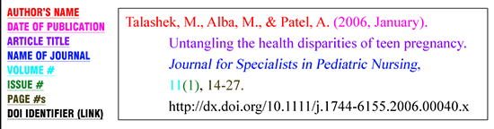
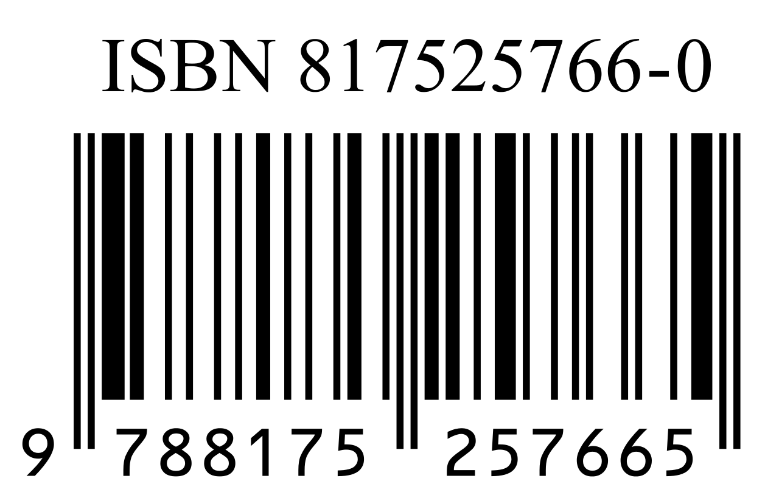
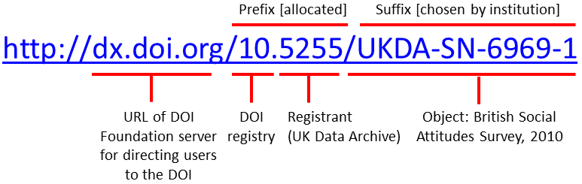

Persistent Identifiers (PIDS): what Are they?
Notes:
“A persistent identifier (PID) is a long-lasting reference to a digital object, either a single file or a set of files.”
http://dx.doi.org/10.5255/UKDA-SN-6969-1

Slide 4

Persistent Identifiers (PIDS): what Are they?
“A persistent identifier (PID) is a long-lasting reference to a digital object, either a single file or a set of files.”
similar to a URL (but not quite)
not just unique, but persistent
resource PID not strictly bound to a specific organisation, server or filename
PID points to a resource ignoring its content/meaning (‘resource agnostic’)
each PID is looked after by the organisation that is responsible for the resource
owner responsible for keeping PID up-to-date when the resource changes

Slide 5
Sounds Boring – why should I care?
not just for now but for the future (persistence)
verifiability, replicability of research
track impact of that resource and its versions
data sharing, accountability, transparency
Notes:
Think for a moment: you would like to see today’s programme and check out your favourite session. You try the link you had bookmarked yesterday, but this is no longer there. You try the same with one of the data source you were referencing in a paper you wrote 10 years ago.
Not just for now but for the future
Verifiability, replicability of research
Easier to keep track of impact of that resource and of the different iterations it’s had throughout its life time (regardless of change of organisation, renaming the resource,
Encouraging a culture of data sharing, accountability, transparency

Slide 6
Persistent Identifiers: SOME examples
There are several standards currently at a fair level of development:
Uniform Resource Name (URN) - urn:isbn:0451450523
persistent URL (PURL)
Handle system – 20.1000/100; http://hdl.handle.net/10.1000/182
digital object identifier (DOI) - doi:10.1002/0470841559.ch1
Archival Resource Key (ARK) - [http://NMAH/]ark:/NAAN/Name[Qualifier]
Open URL - http://resolver.example.edu/cgi?genre=book&isbn=0836218310&title=The+Far+Side+Gallery+3

Slide 7
PIds & Admin Data: ChallengeS
at the point of creation:
messy/unstructured
dynamic
not consistent documentation
various formats
open to restricted
Notes:
Dynamic: a lot of change involved

Slide 8
PIds & Admin Data: ChallengeS
at the point of use:
various formats (snapshot of bespoke dataset to API queried data)
open to restricted official
capturing syntax/code used to extract and other value added documentation

Slide 9
PIds & Admin Data: ChallengeS
at the point of dissemination:
track impact and reach of resource (research, policy)
identify the resource over multiple dimensions (time, ownership, derivatives)

Slide 10
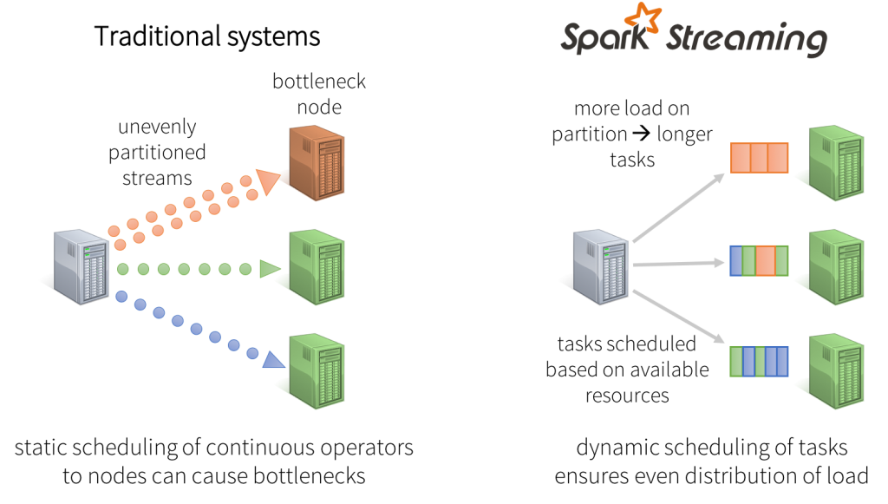
Stream data (databricks.com)
Notes:
In the data stream model, some or all of the input data that are to be operated on are not available for random access from disk or memory, but rather arrive as one or more continuous data streams. Data streams differ from the conventional stored relation model in several ways:
The data elements in the stream arrive online.
The system has no control over the order in which data elements arrive to be processed, either within a data stream or across data streams.
Data streams are potentially unbounded in size.
Once an element from a data stream has been processed it is discarded or archived — it cannot be retrieved easily unless it is explicitly stored in memory, which typically is small relative to the size of the data streams.
Operating in the data stream model does not preclude the presence of some data in conventional stored relations. Often, data stream queries may perform joins between data streams and stored relational data. For the purposes of this paper, we will assume that if stored relations are used, their contents remain static. Thus, we preclude any potential transaction-processing issues that might arise from the presence of updates to stored relations that occur concurrently with data stream processing

Slide 11
Stream Data (Babcock et al 2002)
The data elements in the stream arrive online.
The system has no control over the order in which data elements arrive to be processed, either within a data stream or across data streams.
Data streams are potentially unbounded in size.
Once an element from a data stream has been processed it is discarded or archived — it cannot be retrieved easily unless it is explicitly stored in memory, which typically is small relative to the size of the data streams.
Notes:
In the data stream model, some or all of the input data that are to be operated on are not available for random access from disk or memory, but rather arrive as one or more continuous data streams. Data streams differ from the conventional stored relation model in several ways:
The data elements in the stream arrive online.
The system has no control over the order in which data elements arrive to be processed, either within a data stream or across data streams.
Data streams are potentially unbounded in size.
Once an element from a data stream has been processed it is discarded or archived — it cannot be retrieved easily unless it is explicitly stored in memory, which typically is small relative to the size of the data streams.
Operating in the data stream model does not preclude the presence of some data in conventional stored relations. Often, data stream queries may perform joins between data streams and stored relational data. For the purposes of this paper, we will assume that if stored relations are used, their contents remain static. Thus, we preclude any potential transaction-processing issues that might arise from the presence of updates to stored relations that occur concurrently with data stream processing

Slide 12
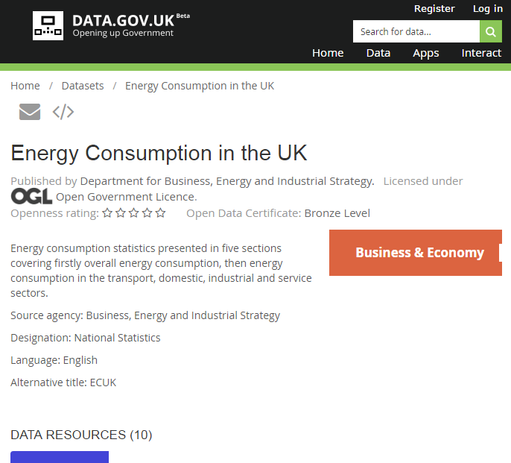
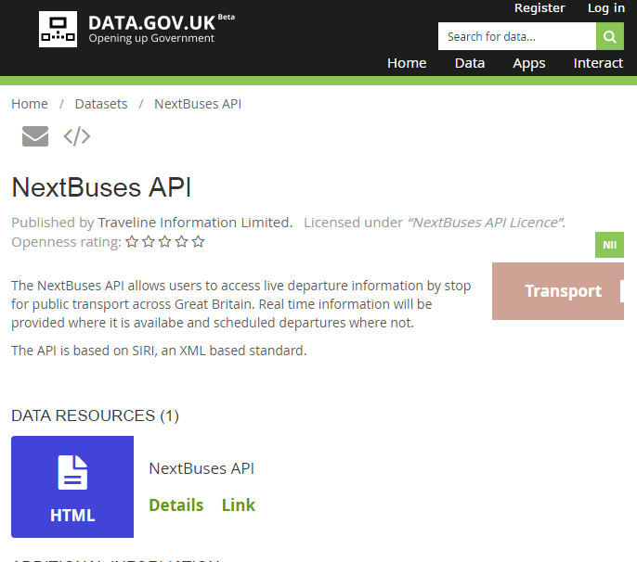
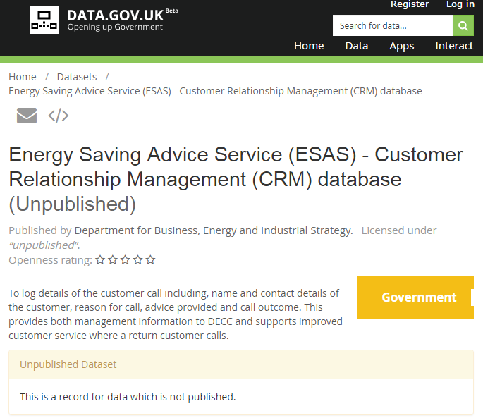
PIds & UK Admin Data: ways forward

Slide 13
PIds & UK Admin Data: ways forward
For bespoke snapshots of data – treat like any other dataset e.g.
http://dx.doi.org/10.5255/UKDA-SN-6969-1
For dynamic administrative data, learn from stream data
Persistently identify the query/code to extract, manipulate and analyse the subset
Record changes/versioning of live dataset (at record and collection level)

Slide 14

Questions?
achats@essex.ac.uk
@kakiac
kakiachatsiou.my-board.org

Slide 15
With thanks
Staff at UK Data Archive, Administrative Data Service, and the Catalyst project at the University of Essex as well as colleagues across the ADRN for insights and helpful suggestions.
Sources:
EUDAT, Introduction to persistent Identifiers, https://www.slideshare.net/EUDAT/introduction-to-persistent-identifiers
Tonkin, E. Persistent Identifiers: Considering the Options. ARIADNE, http://www.ariadne.ac.uk/issue56/tonkin

Slide 16
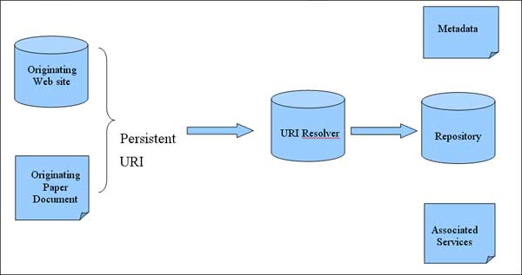
Resolving PIDs – how It works

Slide 18
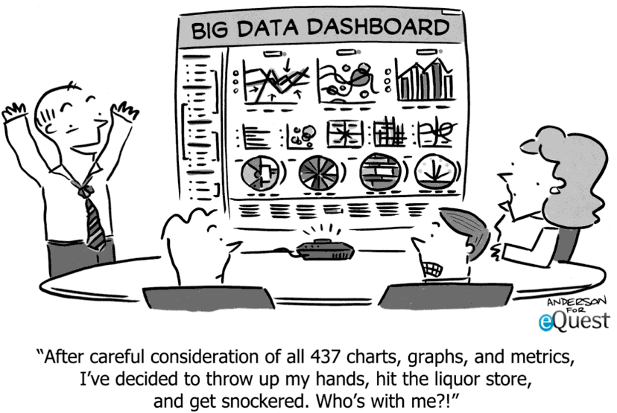

Slide 19


Slide 20
